Slide 1
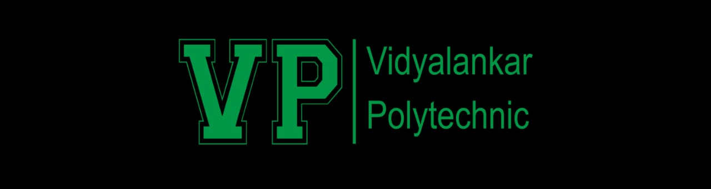

InfoSec 101: Protecting Information Assets in the Digital Age

Slide 2

What is Information Security?
Definition
Key Focus
Protecting information from unauthorized access, misuse, or damage.
Confidentiality, integrity, and availability.

Slide 3
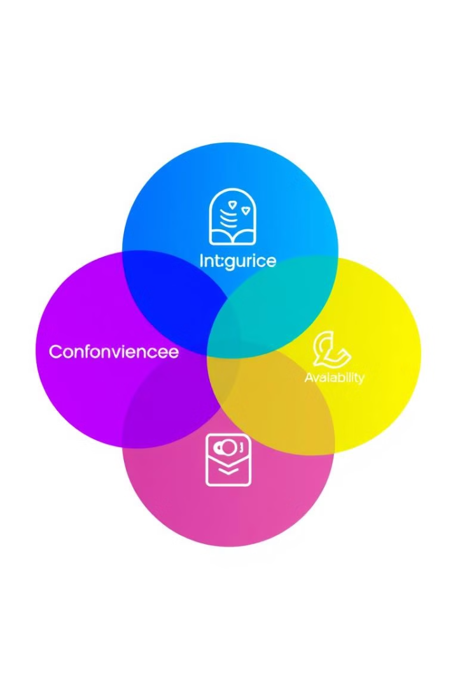
The CIA Triad
1
Confidentiality
2
Integrity
Preventing unauthorized access to data.
Ensuring data remains accurate and unaltered.
3
Availability
Ensuring systems and data are accessible when needed.

Slide 4
Key Areas of Information Security
Network Security
Application Security
Data Security
Protects networks from cyberattacks.
Ensures secure software development and deployment.
Protects data at rest and in transit.
Cloud Security
Endpoint Security
Safeguards cloud-hosted resources.
Protects devices like laptops and smartphones.

Slide 5
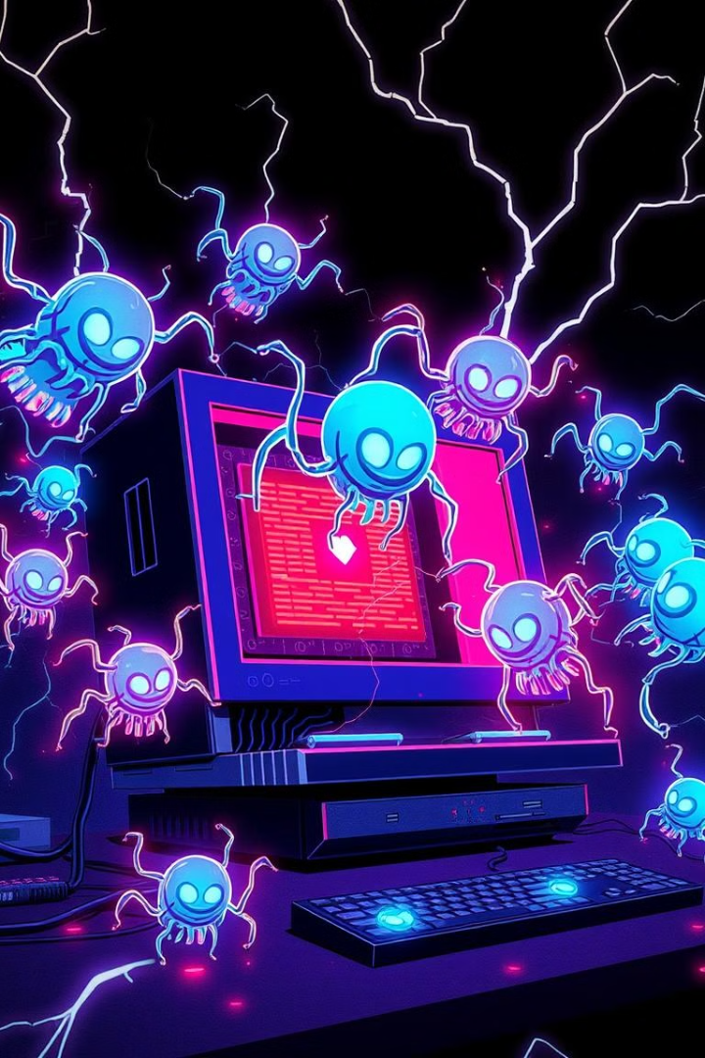




Common Threats
Malware
Phishing
Viruses, ransomware, worms.
Social engineering to steal credentials.
DDoS Attacks
Insider Threats
Overloading systems to disrupt services.
Risks from within the organization.

Slide 6





Tools and Technologies
Firewalls
Block unauthorized access.
Antivirus Software
Detect and remove malware.
Encryption
Protect data by making it unreadable without a key.
SIEM Tools
Real-time monitoring and analysis of security events.
Penetration Testing Tools
Simulate attacks to find vulnerabilities.

Slide 7
Best Practices
Strong Passwords
1
Use strong passwords and enable multi-factor authentication (MFA).
2
Software Updates
Regularly update software and patch vulnerabilities.
Employee Education
3
Educate employees on recognizing phishing and social engineering attacks.
4
Data Backup
Backup critical data frequently.
Least Privilege Access
5
Implement least privilege access policies.
6
Security Audits
Conduct regular security audits.

Slide 8
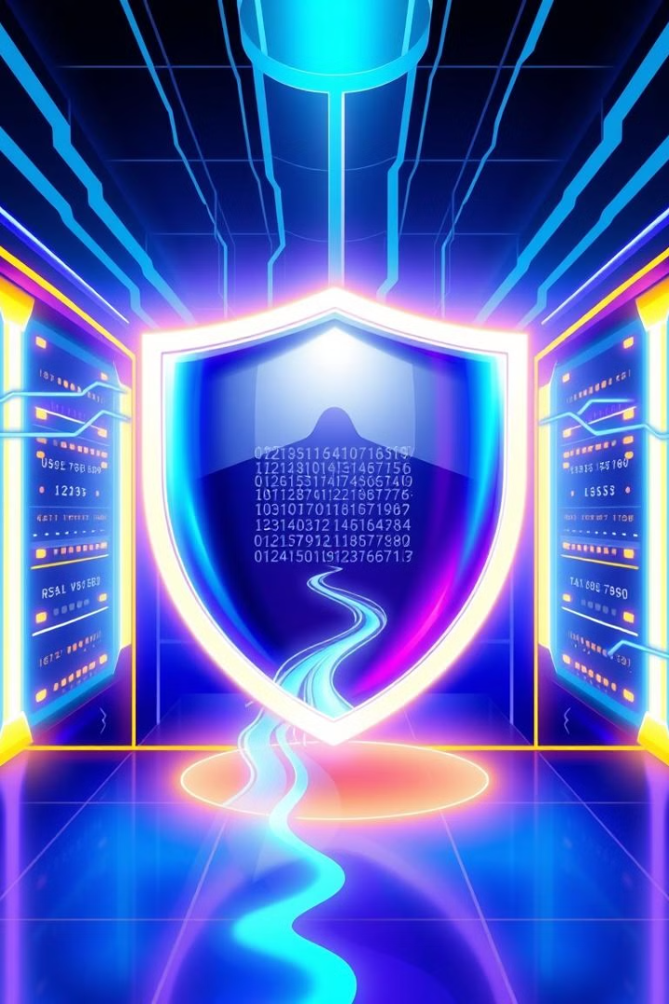
Conclusion
Information security is essential for protecting data in the modern digital world. A multi-layered approach combining technology, policies, and awareness is vital. Stay vigilant, stay secure!

